Slide 1

Fast Fourier Transform
IN THE NAME OF ALLAH
FFT
The Butterfly Algorithm
Algorithm design and analysis
Seyed Mahdi Mahdavi Mortazavi
Seyed Mohsen Razavi Zadegan Jahromi

Slide 2
Contents
Part 1 – Signal analysis
Discrete signals
Fourier Transform (FT)
Discrete Fourier Transform (DFT)
Applications of Fourier Transform (Frequency modulation (FM) and noise reduction (filtering))

Slide 3
Contents
Part 2 – Algorithm analysis
Disadvantages of DFT
Fast Fourier Transform (FFT)
Butterfly Algorithm (a solution for FFT method)
Code review
Review some examples
References

Slide 4
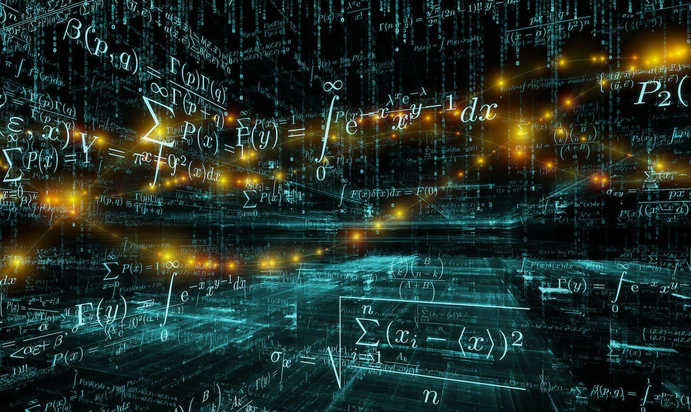
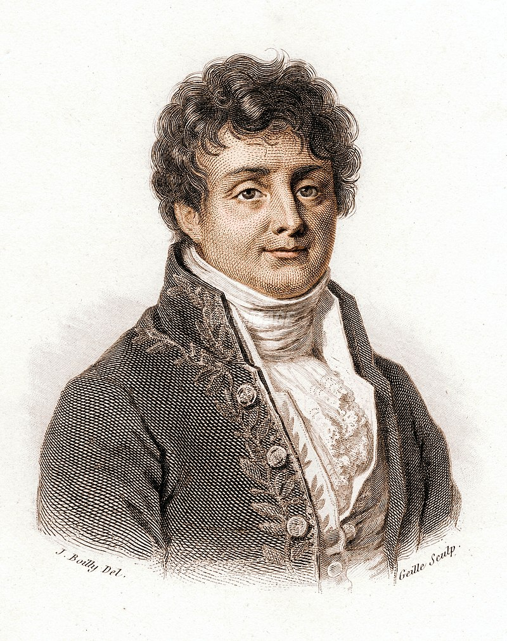
Part 1 – Signal analysis
Joseph Fourier
1768 – 1830

Slide 5
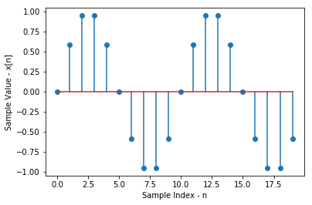
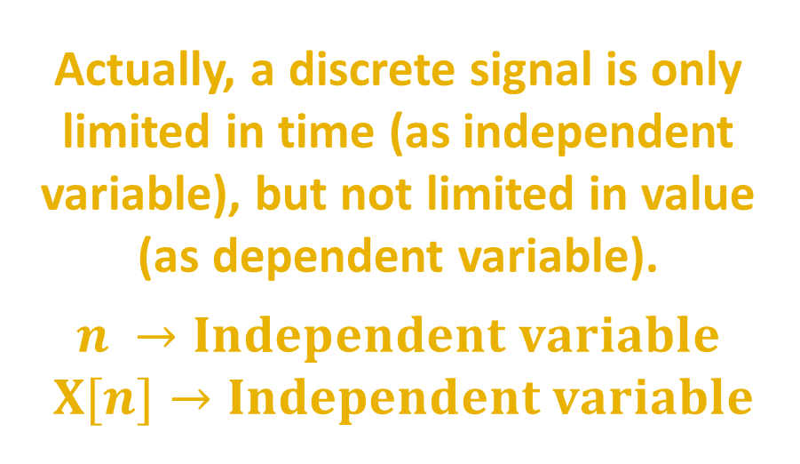
Discrete signal
A discrete signal is a signal (function) that does not have a continuous behavior for all values on the time axis. Actually, the discrete signal is only limited in time (as independent variable), but not limited in value (as dependent variable).
A special form of this signal is the digital signal that we deal with in computers.
Actually, a discrete signal is only limited in time (as independent variable), but not limited in value (as dependent variable).
$$n →Independent variable$$
$$X[n]→Independent variable$$

Slide 6
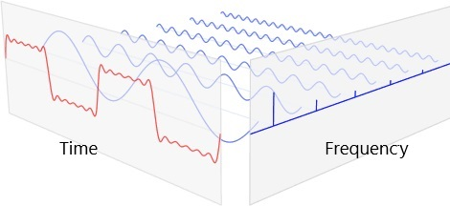
Fourier Transform (FT)
At first, let’s check the concept of Fourier Transform:
Fourier transform is usually used to convert a signal in the time spectrum to a signal in the frequency spectrum. Examples of waves in the time spectrum are audio signals, electrical signals, and mechanical vibrations.
The Fourier transform actually uses the principle that any nonlinear function can be represented by an infinite sum of sine waves. The image below shows the concept of displaying a signal with the sum of sinusoidal signals.
The Fourier transform decomposes a time-domain signal and provides information about the frequencies of all the sine waves needed to construct the time-domain signal.

Slide 7
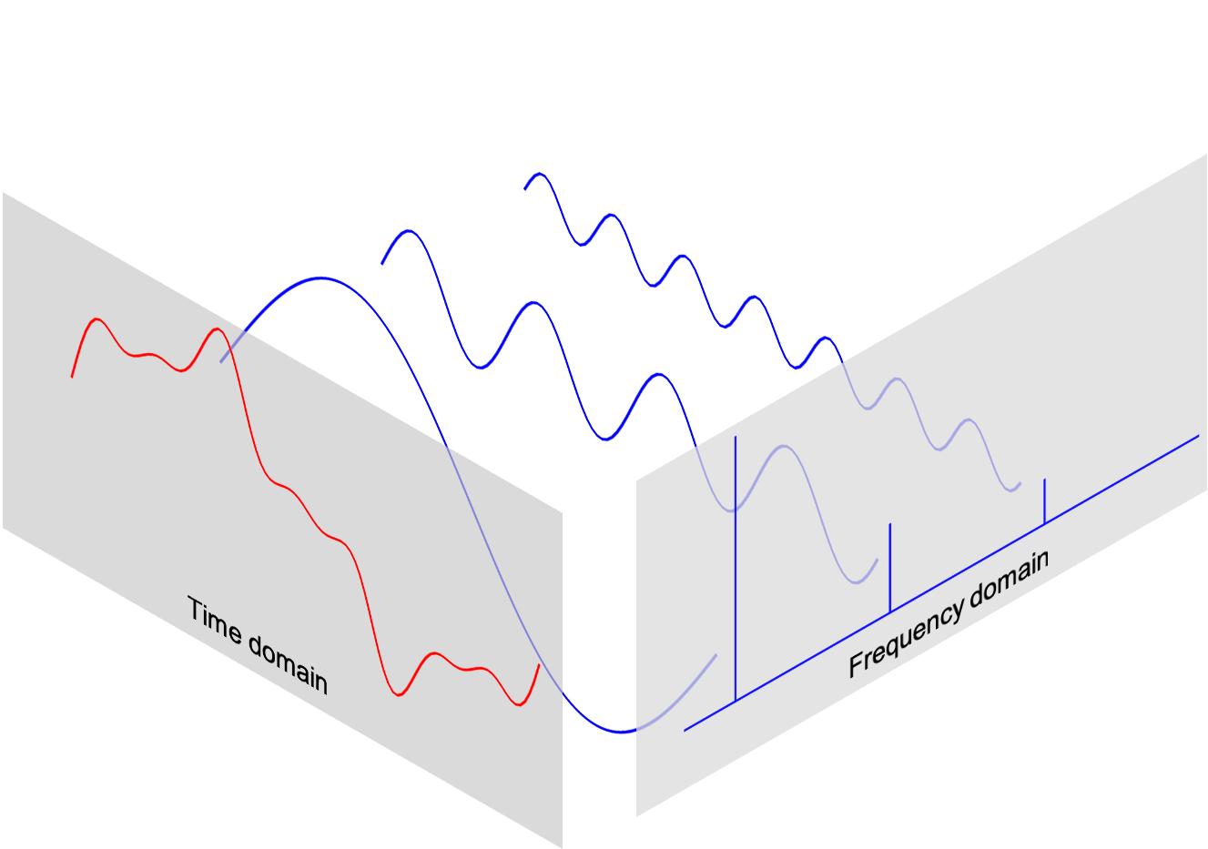
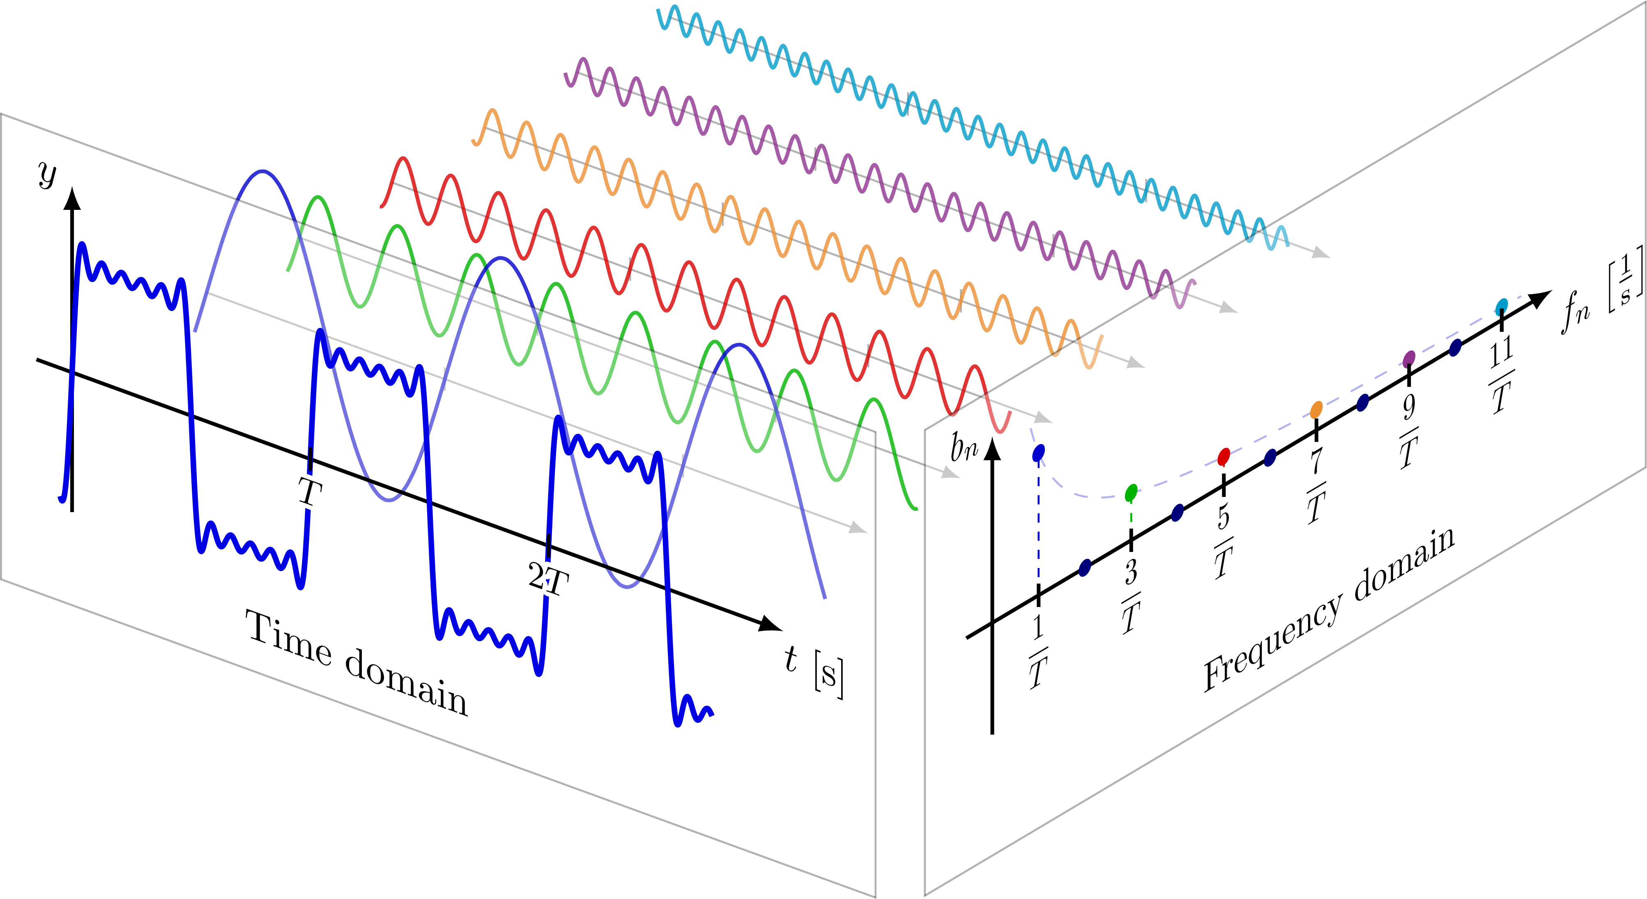
Fourier Transform (other examples)

Slide 8

Discrete Fourier Transform (DFT)
An important concept: Differences between Discrete-time Fourier Transform (DTFT) and Discrete Fourier Transform (DFT):
The Discrete-time Fourier Transform (DTFT) is the (conventional) Fourier transform of a discrete-time signal. Its output is continuous in frequency and periodic; For example: to find the spectrum of the sampled version $x\left(jω\right)$ of a continuous-time signal $x(t)$ or $x\left(e^{jω}\right)$ of a discrete-time signal of $x[n]$.
The Discrete Fourier Transform (DFT) can be seen as the sampled version (in frequency-domain) of the DTFT output. It's used to calculate the frequency spectrum of a discrete-time signal with a computer, because computers can only handle a finite number of values. It is periodic as well and can therefore be continued infinitely.
Method | Input | Output
DTFT | Discrete, Infinite | Continuous, Periodic
DFT | Discrete, Finite | Discrete, Finite

Slide 9
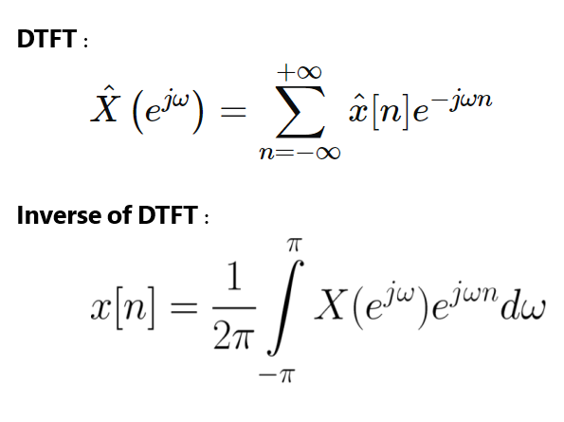
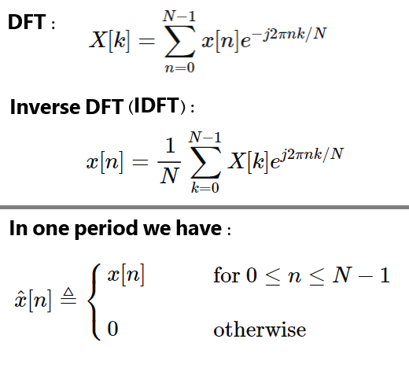
DFT vs DTFT (Formula)
Differences between the formula of DTFT and DFT (mathematical review):
DTFT (and IDTFT) Formula
DFT (and IDFT) Formula

Slide 10

Applications of Fourier Transform
Perhaps the most important reason for using the Fourier transform is to reduce the Noise (denoising).
In signal processing, Noise is a general term for unwanted (in general, unknown) modifications that a signal may suffer during capture, storage, transmission, processing, or conversion.
Two of the best ways to remove signal noise (denoising) are Modulation and Filtering.
Modulation is the encoding of information of a signal in a carrier wave by varying (usually increasing) one of the characteristics of our signal wave;
Wave characteristics: Amplitude, Frequency, Wavelength, Time Period and Speed; Speed of a ways = Frequency $×$ Wavelength $(v=f.λ)$.
One of the best modulations is Frequency Modulation (FM); As you know, most music is played through FM (Frequency Modulation) radio in which we call FM wave.

Slide 11
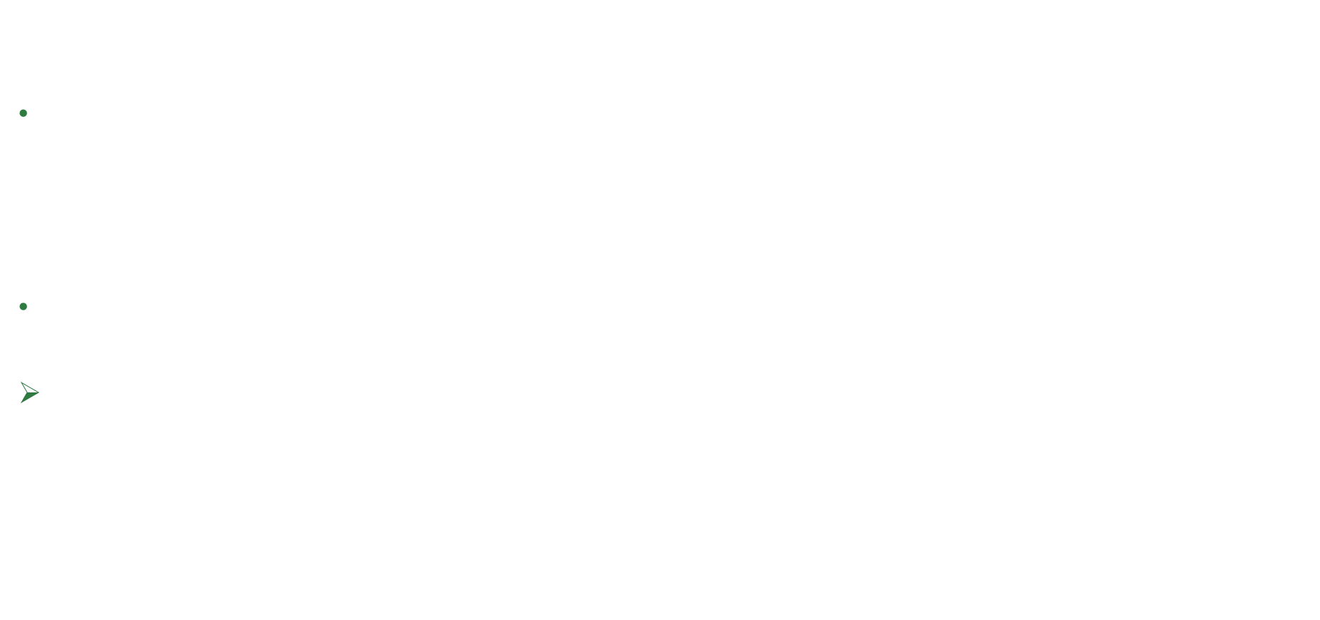
Advantages of Frequency Modulation (FM)
Frequency modulation (FM) is the encoding of information in a carrier wave by varying (usually increasing) the frequency of the wave.
In radio transmission, frequency modulation has a good advantage over other modulation; Actually, Frequency Modulation decreases the noise; hence, there is a significant increase in the signal-to-noise ratio (SNR)*; Meaning it will reject radio frequency interferences much better than other modulations.
It also reduces the interference by the adjacent channels through guard bands.
Due to this major reasons, most music is played through FM (Frequency Modulation) radio (compared to other modulations: Amplitude modulation (AM) and Phase modulation (PM)).
$$∗SNR = \frac{Number of Signal points}{Number of Noisy points}$$

Slide 12
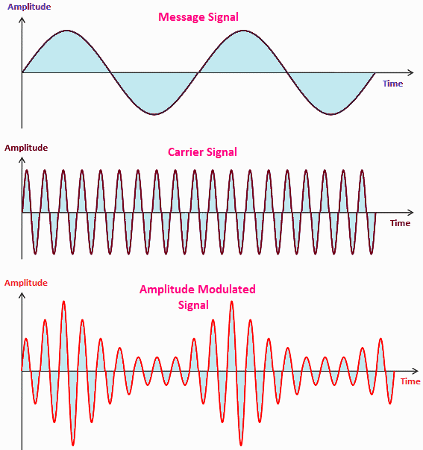
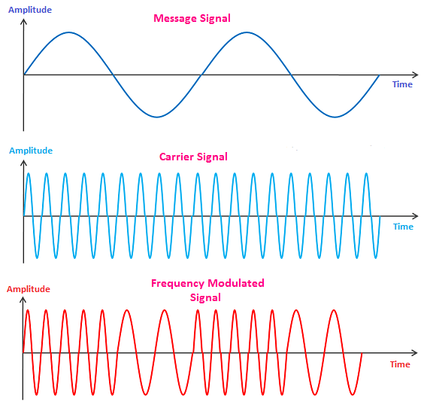
Two Types of Modulation
Amplitude Modulation (AM)
Frequency Modulation (FM)

Slide 13
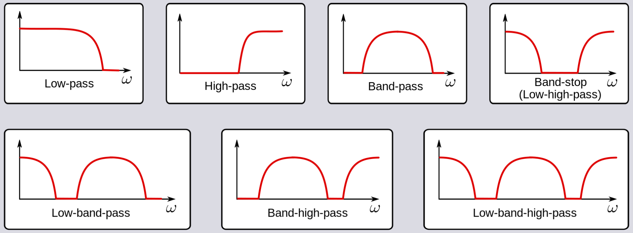
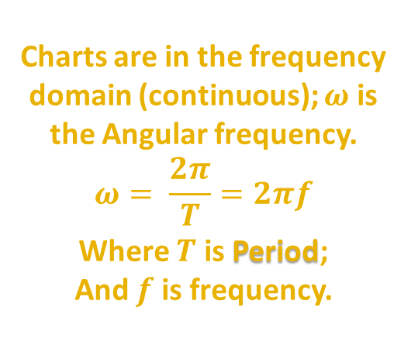
Noise Filtering
Review of different noise reduction (filtering) methods; Low, Band and High pass filters. In signal processing, noise reduction can be achieved in both the time domain as well as frequency domain; In case of the latter, Fourier Transform or Wavelet Transform of the observed signal is obtained and subsequently an appropriate filter is applied. A way to denoising a signal is removing the noised points in frequency domain; How? With using low, band and high pass filters with an index frequency and reject lower or higher frequencies than index frequency (or reject signals between two index frequencies).
Charts are in the frequency domain (continuous); $ω$ is the Angular frequency.
$$ω= \frac{2π}{T}=2πf$$
Where $T$ is Period;
And $f$ is frequency.

Slide 14
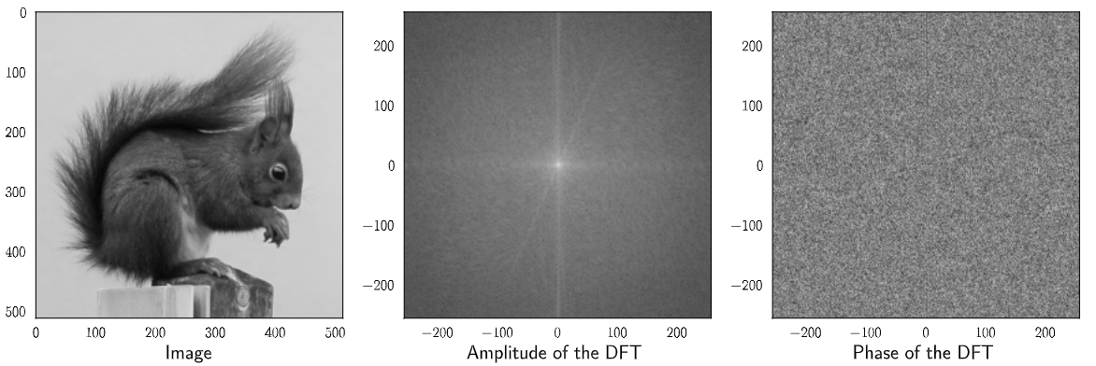
Review some real examples #1
A picture with its Fourier transform (using DFT) signal (Amplitude and Phase)

Slide 15
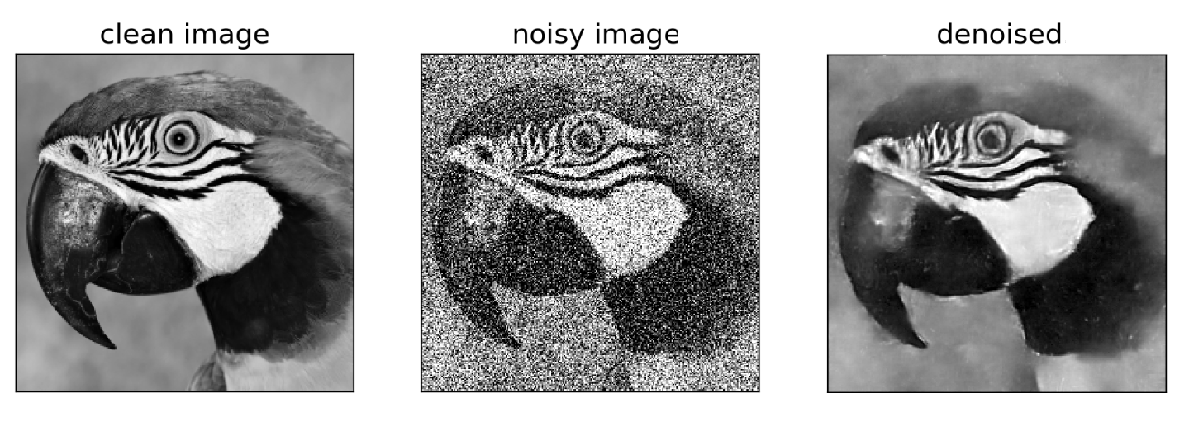
Review some real examples #2
A picture in different states (Clean, Noisy, Denoised) #1

Slide 16
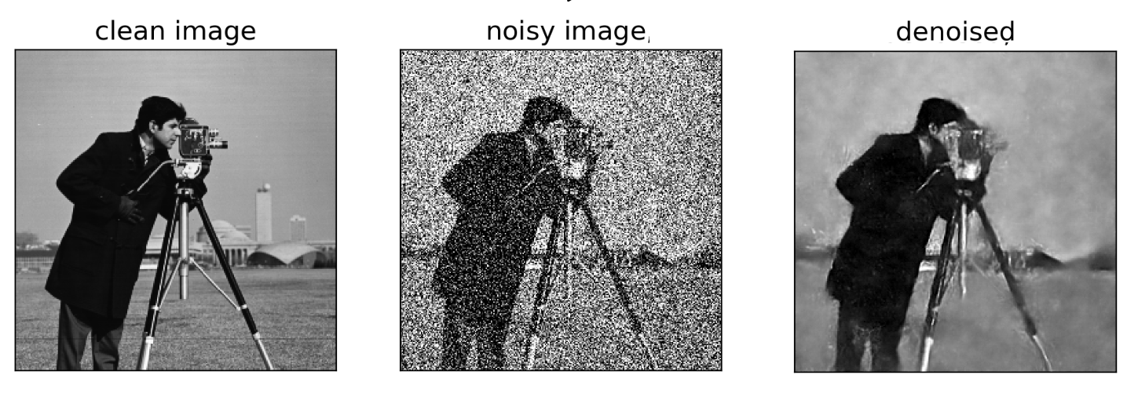
Review some real examples #3
A picture in different states (Clean, Noisy, Denoised) #2

Slide 17

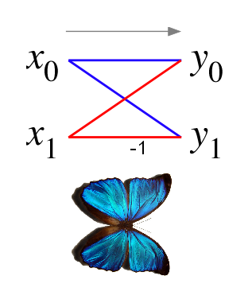
Part 2 – Algorithm analysis
The Butterfly Algorithm

Slide 18
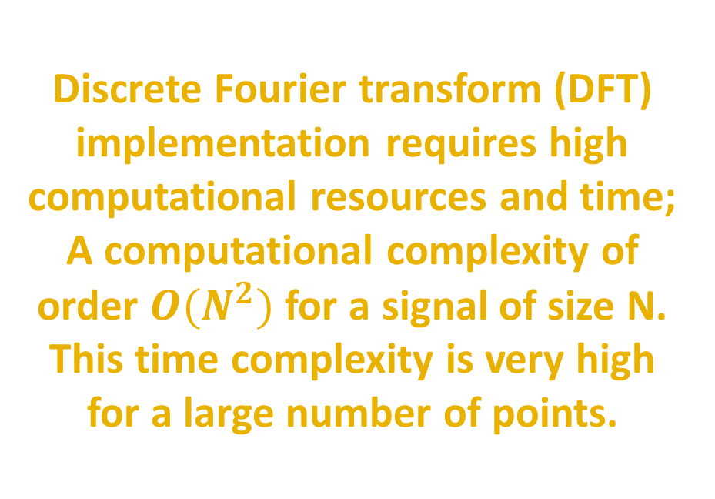
Disadvantages of DFT
Let's review the Discrete Fourier Transform (DFT) formula. As you can see, it has very high time complexity (for many points) and complex calculations.
Discrete Fourier transform (DFT) implementation requires high computational resources and time; A computational complexity of order $O(N^{2})$ for a signal of size N. This time complexity is very high for a large number of points.

Slide 19
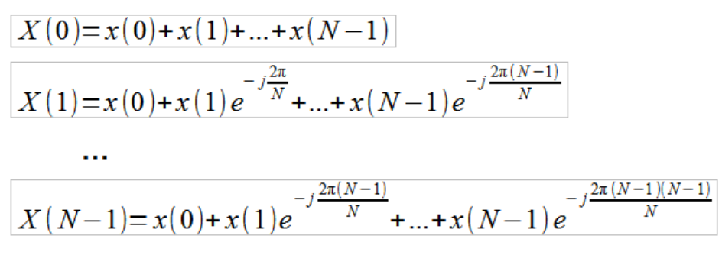
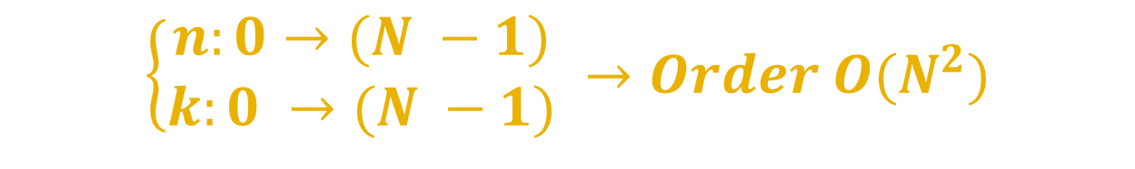
Complexity of DFT
These transformations (with DFT and IDFT) are quite time-consuming and to understand this, we will describe DFT formula in more detail:
$\left\{\begin{aligned}n:0→(N −1) \\ k:0 →(N −1)\end{aligned} →Order O(N^{2})\right.$

Slide 20
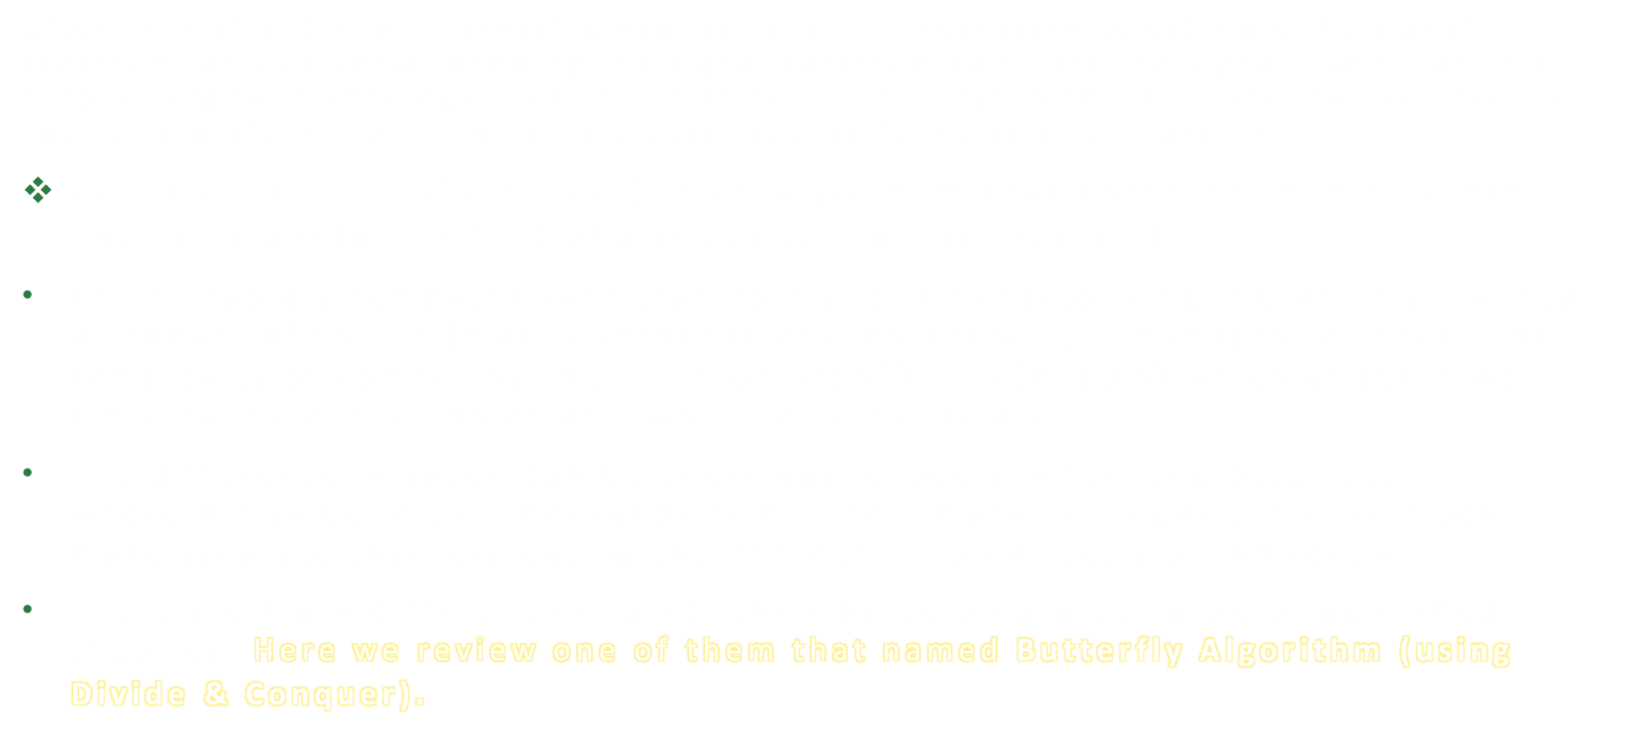
Fast Fourier Transform (FFT)
Often in Digital Signal Processing applications it is necessary to estimate the signal spectrum, or vice versa, knowing the signal spectrum calculate the signal itself. For this purpose digital technology uses the Discrete Fourier Transform (DFT) and Inverse Discrete Fourier Transform (IDFT), which are described by formulas of DFT and IDFT.
Fast Fourier Transform (FFT) is an algorithm that computes the discrete Fourier transform (DFT) of a sequence, or its inverse (IDFT);
An FFT rapidly computes such transformations by factorizing the DFT matrix into a product of sparse (mostly zero) factors. As a result, it manages to reduce the complexity of computing the DFT from $O(n^{2})$ to $O(nlogn)$ which arises if we simplify the definition of DFT, where $n$ is the data size.
The difference in speed can be enormous, especially for long data sets where $n$ may be in the thousands or millions. many FFT algorithms are much more accurate than evaluating the DFT definition directly or indirectly.
There are many different FFT algorithms based on a wide range of published theories; Here we review one of them that named Butterfly Algorithm (using Divide & Conquer).

Slide 21
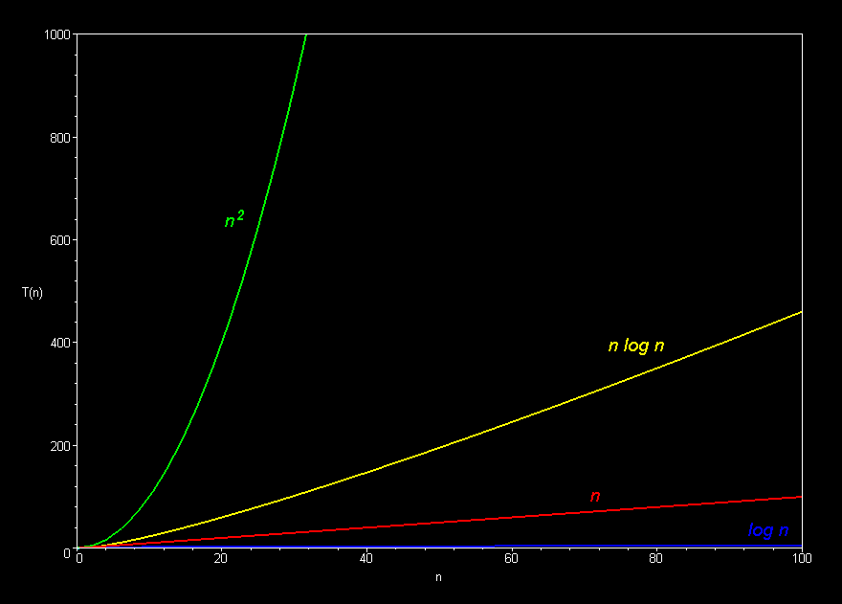
Comparison of Complexities
Comparison between $O\left(N^{2}\right)$ and $O\left(NlogN\right)$

Slide 22

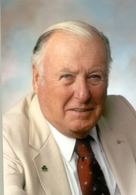
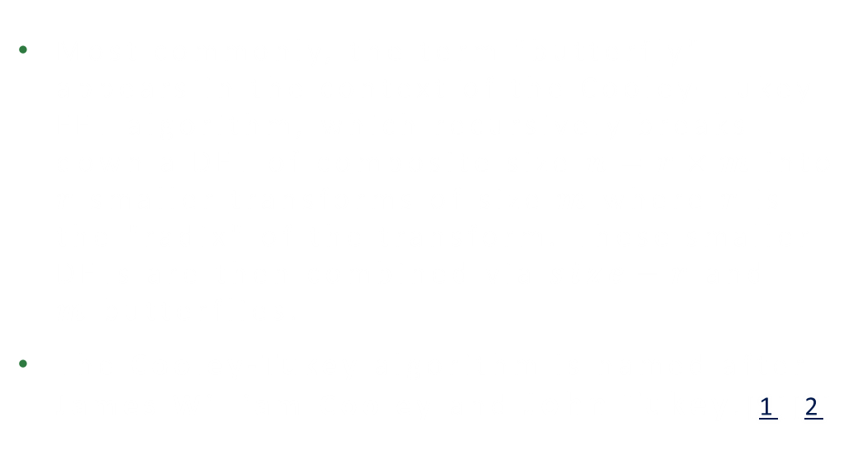
Butterfly algorithm
In the context of fast Fourier transform algorithms, a butterfly is a portion of the computation that combines the results of smaller discrete Fourier transforms (DFTs) into a larger DFT, or vice versa (breaking a larger DFT up into subtransforms).
The name "butterfly" comes from the shape of the data-flow diagram in the radix-2 case, as described in the first slide of Part 2. The earliest occurrence in print of the term is thought to be in a 1969 MIT technical report.
Most commonly, the term "butterfly" appears in the context of the Cooley–Tukey FFT algorithm, which recursively breaks down a DFT of composite size $n=r×m$into $r$ smaller transforms of size $m$ where $r$ is the "radix" of the transform. These smaller DFTs are then combined via $size−r$ and $m$butterflies.
The Cooley-Tukey algorithm is named after James William Cooley and John Tukey.[1][2]
John Wilder Tukey 1915 – 2000
James William Cooley
1926 – 2016

Slide 23

Review an example
Consider this example:
We have 8 points $\left(N=8\right)$; So the DFT formula becomes like this:
$X\left[k\right]=\sum_{n=0}^{7}{\left(x\left[n\right]e^{−\frac{j2πnk}{8}}\right)=x\left[0\right]e^{−\frac{j2πk}{8} × 0}}+$ $x\left[1\right]e^{−\frac{j2πk}{8} ×1}+x\left[2\right]e^{−\frac{j2πk}{8} ×2}+x\left[3\right]e^{−\frac{j2πk}{8} ×3}+x\left[4\right]e^{−\frac{j2πk}{8} ×4}+x\left[5\right]e^{−\frac{j2πk}{8} ×5}+ x\left[6\right]e^{−\frac{j2πk}{8} ×6}+x\left[7\right]e^{−\frac{j2πk}{8} ×7}$
Lets separate Even points and Odd points:
$$Even points: G\left[k\right]=x\left[0\right]e^{−\frac{j2πk}{8} × 0}+x\left[2\right]e^{−\frac{j2πk}{8} × 2}+x\left[4\right]e^{−\frac{j2πk}{8} ×4}+x\left[6\right]e^{−\frac{j2πk}{8} ×6}$$
$$Odd points:H′\left[k\right]=x\left[1\right]e^{−\frac{j2πk}{8} ×1}+x\left[3\right]e^{−\frac{j2πk}{8} ×3}+x\left[5\right]e^{−\frac{j2πk}{8} × 5}+x\left[7\right]e^{−\frac{j2πk}{8} ×7}$$

Slide 24


Review an example
Simplification for Even points:
$$Even points: G\left[k\right]=x\left[0\right]e^{−\frac{j2πk}{8} × 0}+x\left[2\right]e^{−\frac{j2πk}{8} × 2}+x\left[4\right]e^{−\frac{j2πk}{8} ×4}+x\left[6\right]e^{−\frac{j2πk}{8} ×6} →$$
$$G\left[k\right]=x\left[0\right]+x\left[2\right]e^{−\frac{j2πk}{4} }+x\left[4\right]e^{−\frac{j2πk}{4} × 2}+x\left[6\right]e^{−\frac{j2πk}{4} × 3}$$
Simplification for Odd points:
$$Odd points:H′\left[k\right]=x\left[1\right]e^{−\frac{j2πk}{8} × 1}+x\left[3\right]e^{−\frac{j2πk}{8} × 3}+x\left[5\right]e^{−\frac{j2πk}{8} × 5}+x\left[7\right]e^{−\frac{j2πk}{8} × 7}→$$
$$H′\left[k\right]=e^{−\frac{j2πk}{8} }×\left(x\left[1\right]+x\left[3\right]e^{−\frac{j2πk}{8} × 2}+x\left[5\right]e^{−\frac{j2πk}{8} × 4}+x\left[7\right]e^{−\frac{j2πk}{8} × 6}\right)→$$
$$H′\left[k\right]=e^{−\frac{j2πk}{8} }×(x\left[1\right]+x\left[3\right]e^{−\frac{j2πk}{4} }+x\left[5\right]e^{−\frac{j2πk}{4} × 2}+x\left[7\right]e^{−\frac{j2πk}{4} × 3})$$
$$H[k]$$

Slide 25


Review an example
Combining the Even and Odd points:
$$X\left[k\right]=G\left[k\right]+H^{′}\left[k\right]=G\left[k\right]+e^{−\frac{j2πk}{8} } H[k]$$
$G\left[k\right]$ and $H\left[k\right]$ are periodic with period $\left(N = 4\right)$; So lets calculate $G[k+4]$ and $H[k+4]$. To do this we should calculate $X[k+4]$:
$$X\left[k+4\right]=G\left[k+4\right]+e^{−\frac{j2π(k+4)}{8} } H\left[k+4\right] \left\{\begin{aligned}G\left[k\right]=G[k+4] \\ H\left[k\right]=H[k+4] \\ ∗e^{−\frac{j2π(k+4)}{8} }=−e^{−\frac{j2πk}{8} }\end{aligned}\right.$$
$${∗e}^{−\frac{j2π(k+4)}{8} }=e^{−\frac{j2πk}{8} }{. e}^{−\frac{j2π × 4}{8} }=e^{−\frac{j2πk}{8} }{. e}^{−jπ }=−e^{−\frac{j2πk}{8} }$$
$$−1$$

Slide 26

Example to Proof
So we will have:
$$X\left[k\right]=G\left[k\right]+e^{−\frac{j2πk}{8} } H\left[k\right] \\ X\left[k+4\right]=G\left[k\right]−e^{−\frac{j2πk}{8} } H\left[k\right]$$
Finally we can using this conjunction, to decrease the complexity of the DFT. Generally we have this (if we have $N$ points):
$$X\left[k\right]=G\left[k\right]+e^{−\frac{j2πk}{N} } H\left[k\right] \\ X\left[k+N/2\right]=G\left[k\right]−e^{−\frac{j2πk}{N} } H\left[k\right]$$
Note: $N$ must be a power of 2; Why? Refer to Slide 22;

Slide 27
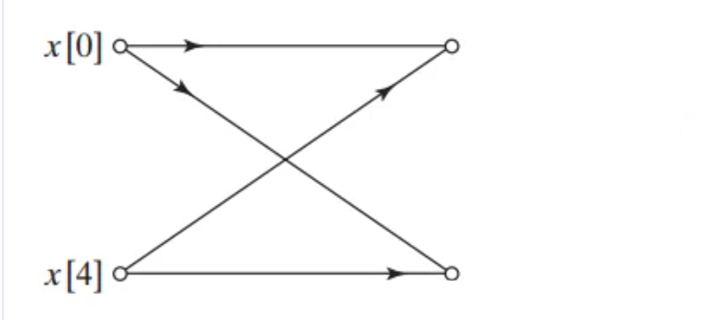


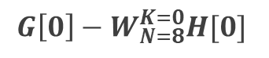

Butterfly algorithm diagram
Suppose that $e^{−\frac{j2πk}{N} }= W_{N}^{k}$, then we have this diagram for $N = 8$:
Did you see the Butterfly?!
$$G\left[0\right]+W_{N= 8}^{K=0}H[0]$$
$$G\left[0\right]−W_{N=8}^{K=0}H[0]$$
$$k=0\left\{\begin{aligned}X\left[0\right]=G\left[0\right]+e^{−\frac{j2π(0)}{N} } H\left[0\right] \\ \\ X\left[0+(\frac{8}{2}=4)\right]=G\left[0\right]−e^{−\frac{j2π\left(0\right)}{N} } H[0]\end{aligned}\right.$$

Slide 28
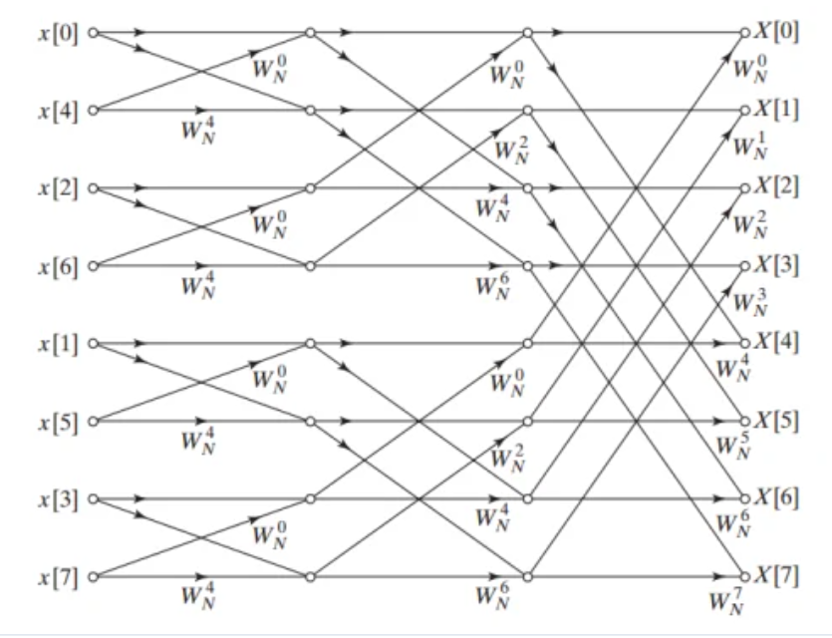

Butterfly algorithm diagram
${ e}^{−\frac{j2πk}{N} }= W_{N}^{k}$
$N = 8$

Slide 29
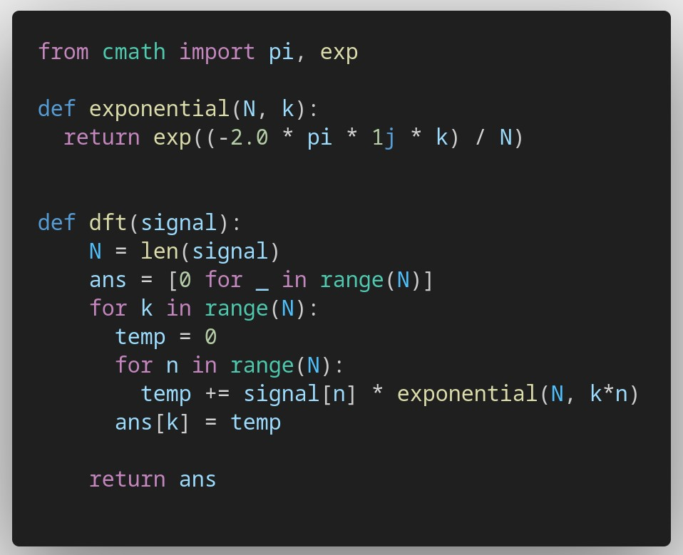
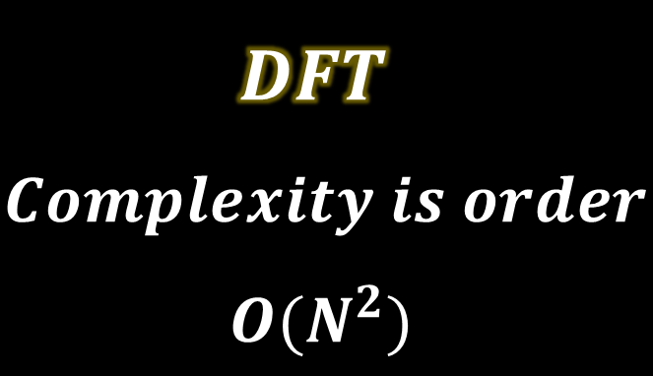
Code review #1
$$DFT$$
$$Complexity is order$$
$$O(N^{2})$$

Slide 30
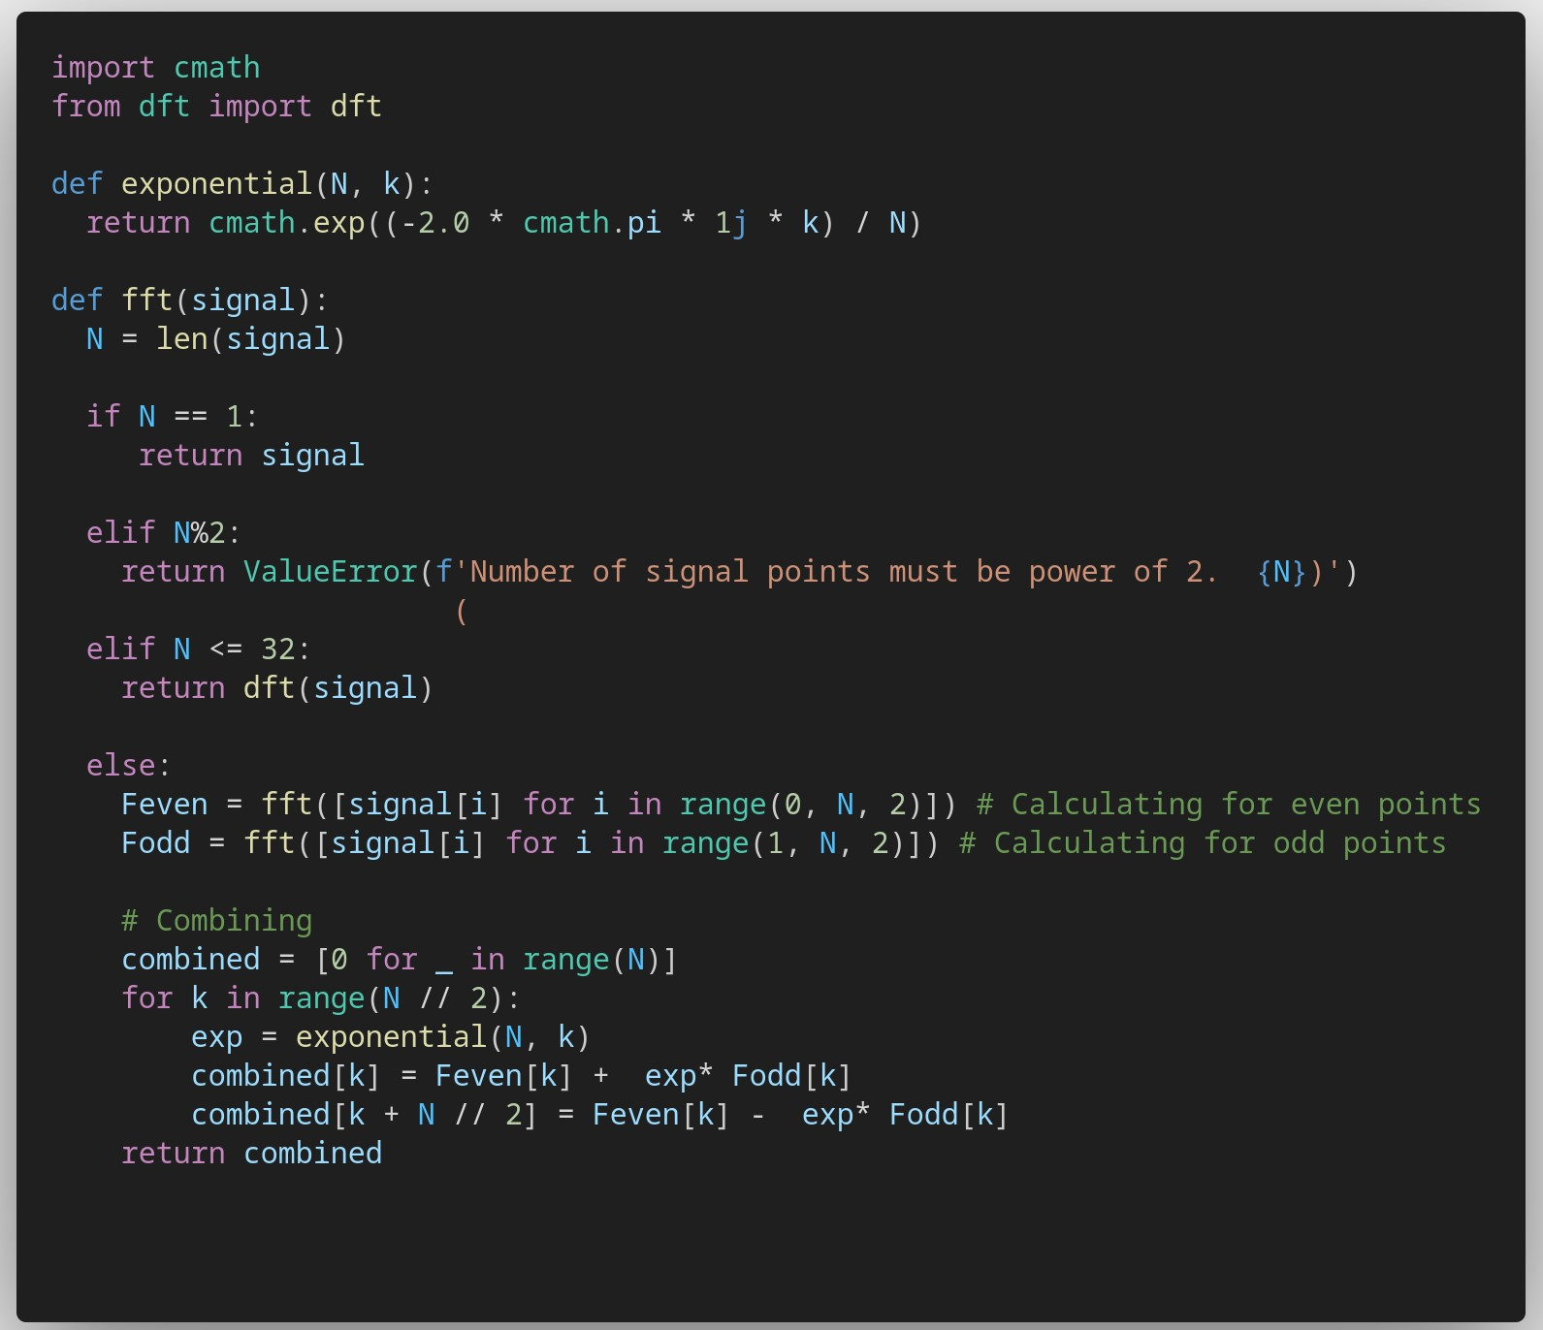

$$FFT$$

Slide 31

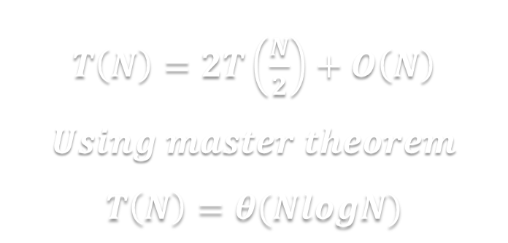
Code review #2
$$FFT$$
$$X\left[k\right]=G\left[k\right]+e^{−\frac{j2πk}{N} } H\left[k\right] \\ X\left[k+N/2\right]=G\left[k\right]−e^{−\frac{j2πk}{N} } H\left[k\right]$$
$T\left(N\right)=2T\left(\frac{N}{2}\right)+O\left(N\right)$ $Using master theorem$
$$T\left(N\right)=θ(NlogN)$$

Slide 32
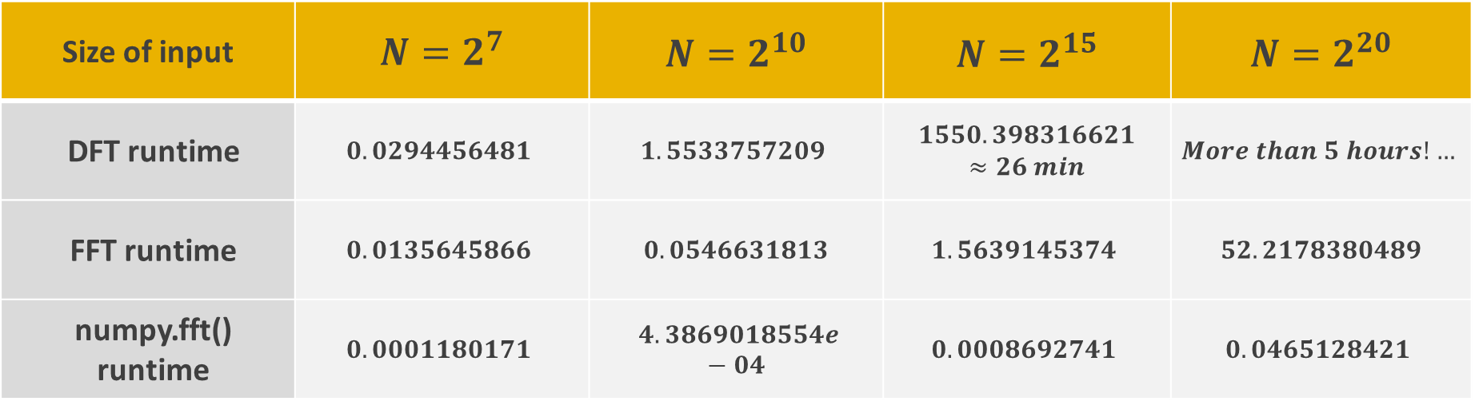
Review some examples
Runtime of different test cases in seconds.
For each test case, answers are similar up to 10 decimal places.
Size of input | $N=2^{7}$ | $N=2^{10}$ | $N=2^{15}$ | $N=2^{20}$
DFT runtime | $$0.0294456481$$ | $$1.5533757209$$ | $1550.398316621 ≈26 min$ | $$More than 5 hours!…$$
FFT runtime | $$0.0135645866$$ | $$0.0546631813$$ | $$1.5639145374$$ | $$52.2178380489$$
numpy.fft() runtime | $$0.0001180171$$ | $$4.3869018554e−04$$ | $$0.0008692741$$ | $$0.0465128421$$

Slide 33
References
Faradars – FFT[1]
Wikipedia – FFT[1], Butterfly Alg[2]
Youtube – Most Important Algorithm of all time[1], MIT Course about Divide and Conquer for FFT[2]
DSP-Weimich – Fast Fourier Transform and their C realizations using the octave gnu tool[1]
The most used references in this article

Slide 34

Thank You.
FFT
Seyed Mahdi Mahdavi Mortazavi
Seyed Mohsen Razavi Zadegan Jahromi
The Butterfly Algorithm
Github repos:
https://github.com/theMHD-120/fft
https://github.com/MohsenRazavi/fft

